Slide 1

Customer Shopping Behavior Analysis
This project analyzes customer shopping behavior using transactional data from 3,900 purchases. The goal is to uncover insights into spending patterns, customer segments, product preferences, and subscription behavior to guide strategic business decisions.
Data Scope
3,900 purchases analyzed across various product categories.
Key Focus Areas
Spending patterns, customer segmentation, product preferences, and subscription behavior.

Slide 2
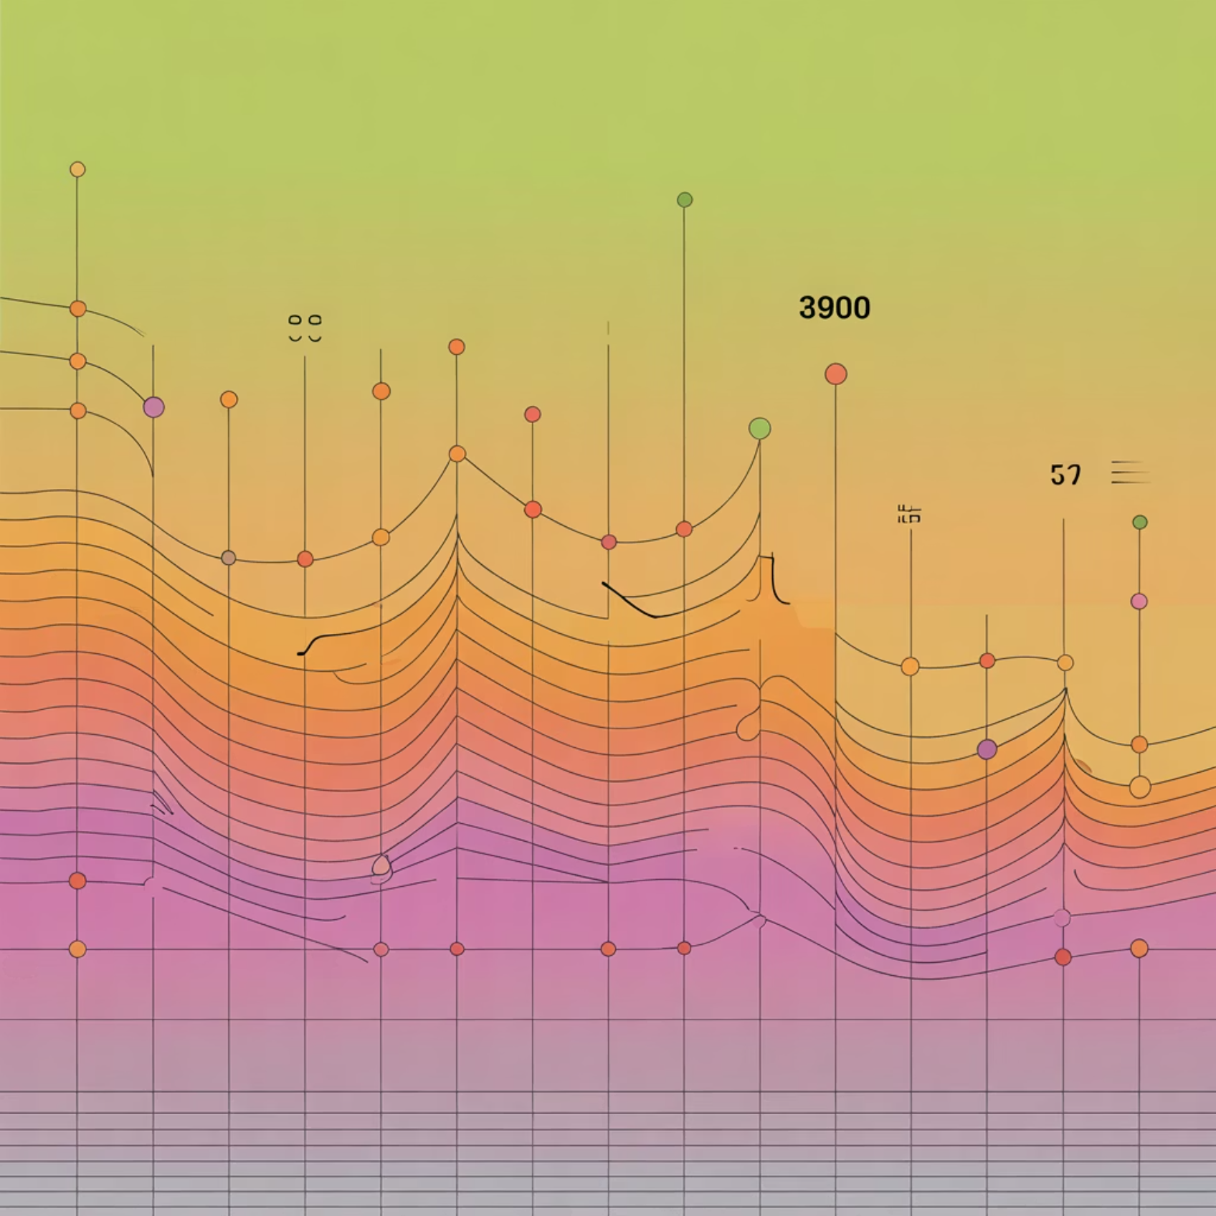

Dataset Summary and Key Features
The dataset comprises 3,900 rows and 18 columns, capturing comprehensive details about customer demographics, purchase specifics, and shopping behavior.
Key Features Included
Customer demographics (Age, Gender, Location, Subscription Status)
Purchase details (Item, Category, Amount, Season, Size, Color)
Shopping behavior (Discount Applied, Previous Purchases, Review Rating, Shipping Type)
Missing Data Note: 37 values were missing in the Review Rating column, which were handled during data preparation.

Slide 3

Exploratory Data Analysis (EDA) in Python
The initial phase involved data preparation and cleaning using Python's pandas library to ensure data quality and consistency before analysis.
Missing Data Handling
Data Loading & Exploration
Null values in 'Review Rating' were imputed using the median rating of each product category.
Imported dataset and used df.info() and .describe() to check structure and summary statistics.
Feature Engineering
Column Standardization
Created age_group by binning ages and calculated purchase_frequency_days.
Renamed columns to snake case for improved readability and documentation.

Slide 4
Key Business Insights: Revenue and Spending
Structured analysis in PostgreSQL provided clear answers to key business questions regarding revenue distribution and customer spending habits.
Revenue by Gender
Subscribers vs. Non-Subscribers
Female
75,191
Yes (1053 customers)
59.49
62,645
Male
157,890
No (2847 customers)
59.87
170,436
Male customers generated significantly higher total revenue than female customers.
Non-subscribers account for the majority of customers and total revenue, with a slightly higher average spend.

Slide 5

Product Performance and Customer Segmentation
We analyzed product ratings and segmented the customer base to understand loyalty and product appeal.
1
2
Top 5 Products by Rating
Customer Segments
Loyal: 3,116 customers
Gloves: 3.86
Returning: 701 customers
Sandals: 3.84
New: 83 customers
Boots: 3.82
3
Shipping Type Comparison
Average purchase amount is slightly higher for Express shipping ($60.48) compared to Standard ($58.46).

Slide 6
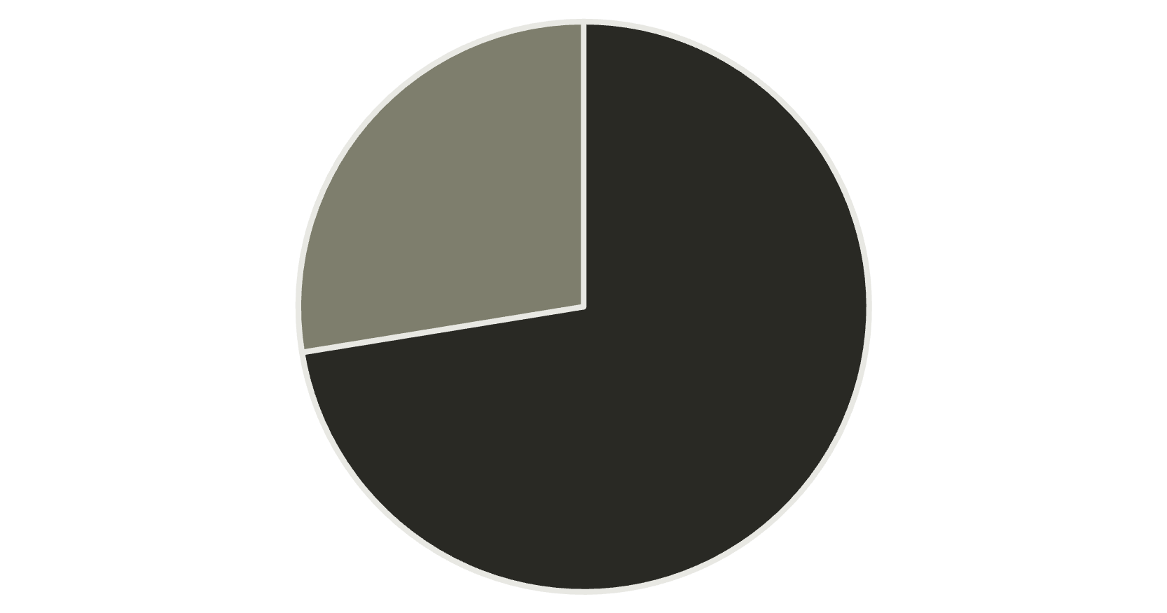
Discount Dependency and Repeat Buyers
Understanding which products are most reliant on discounts and the subscription habits of repeat buyers is crucial for margin control and retention strategy.
Top 5 Discount-Dependent Products
Repeat Buyers & Subscriptions
These products had the highest percentage of discounted purchases, indicating potential price sensitivity:
Customers with more than 5 previous purchases were analyzed for subscription likelihood:
Hat (50.00% discount rate)
Sneakers (49.66%)
Coat (49.07%)
Sweater (48.17%)
Pants (47.37%)
No
Yes
While the majority of repeat buyers are not subscribed, a significant portion (958) are, suggesting a strong correlation between loyalty and subscription.

Slide 7

Product Hierarchy: Top 3 Items per Category
Analyzing the most purchased items within each major category helps prioritize inventory and marketing efforts.
Accessories
Jewelry (171 orders)
Sunglasses (161 orders)
Belt (161 orders)
Clothing
Blouse (171 orders)
Pants (171 orders)
Shirt (169 orders)
Footwear
Sandals (160 orders)
Shoes (150 orders)
Sneakers (145 orders)
Outerwear
Jacket (163 orders)
Coat (161 orders)

Slide 8
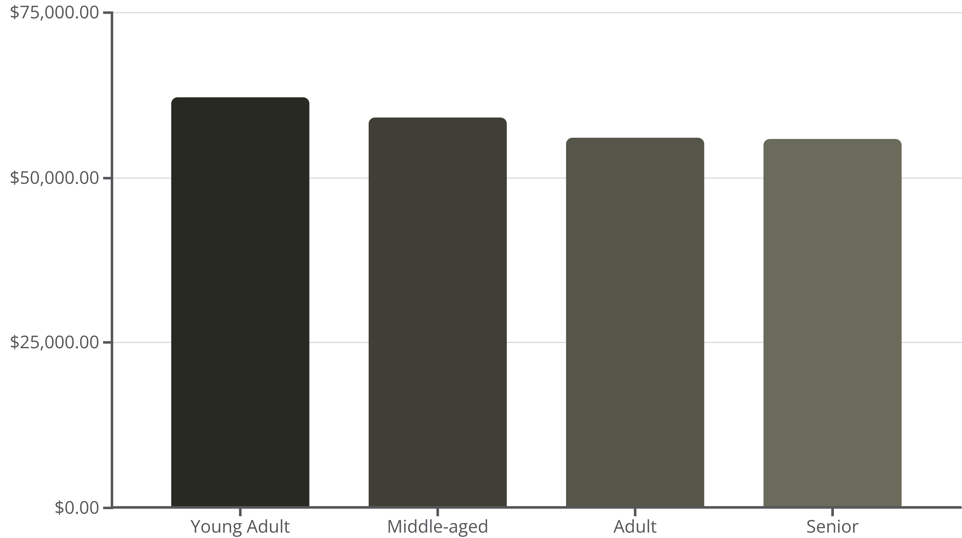
Revenue Contribution by Age Group
Understanding which age groups contribute the most revenue allows for precise demographic targeting in marketing campaigns.
The Young Adult segment generates the highest total revenue, followed closely by Middle-aged customers. All four groups show relatively balanced contribution, but the Young Adult group is the most valuable.

Slide 9



Strategic Business Recommendations
Based on the data analysis, we propose five key recommendations to optimize sales, loyalty, and profitability.
Boost Subscriptions
Promote exclusive benefits and premium content to increase the number of subscribers, especially among repeat buyers.
Customer Loyalty Programs
Implement structured rewards to incentivize repeat purchases and move customers into the highly valuable "Loyal" segment.
Review Discount Policy
Carefully balance sales boosts with margin control, particularly for discount-dependent products like Hats and Sneakers.
Product Positioning
Highlight top-rated products (e.g., Gloves, Sandals) and best-sellers in marketing campaigns to leverage social proof.
Targeted Marketing
Focus efforts on high-revenue age groups (Young Adults) and users who prefer Express shipping, as they demonstrate higher spending potential.

